Slide 1
The Web Archive and The Catalogue
Andy Jackson
Web Archive Technical Lead

Slide 2
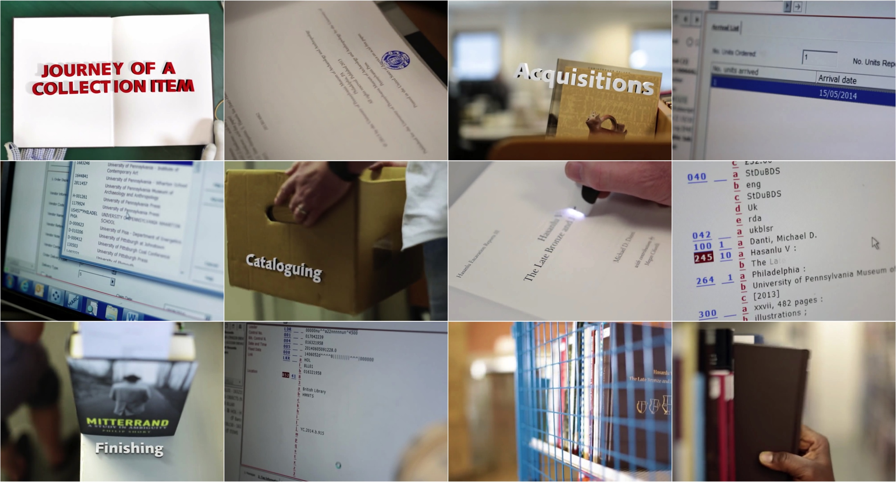
Journey of a (print) collection item

Slide 3
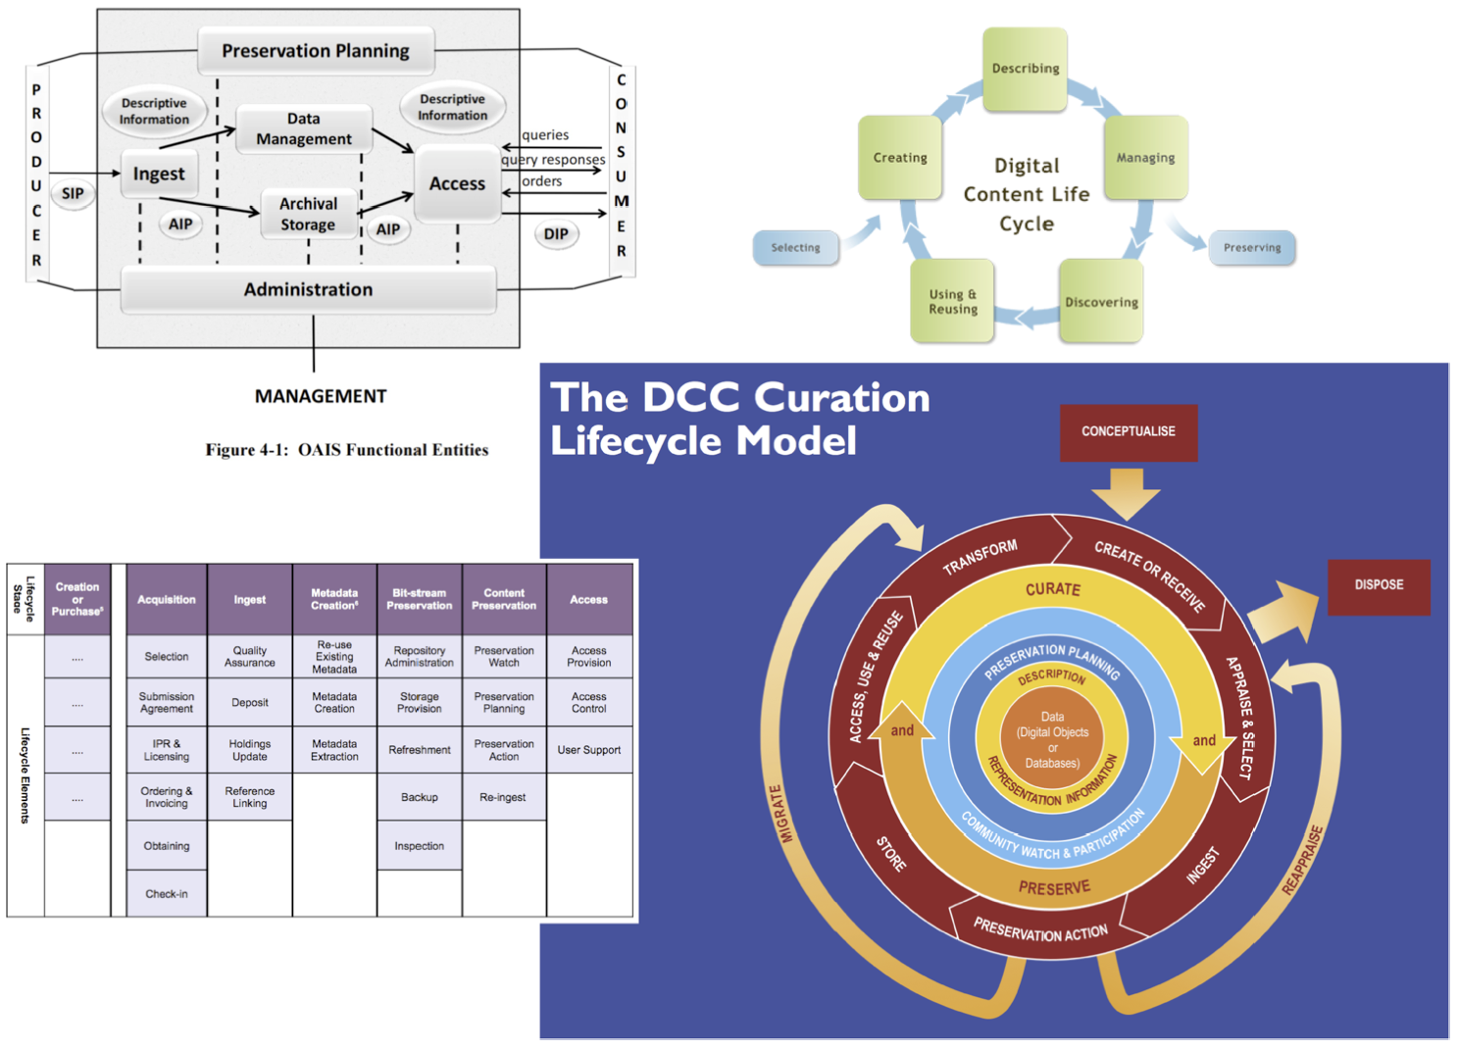
Chains of events

Slide 4
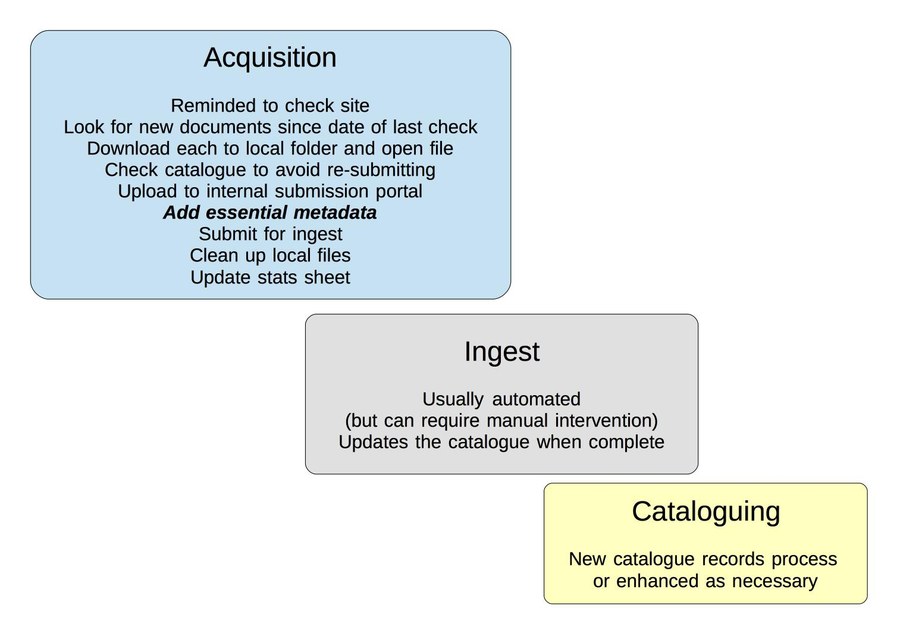
Original Digital Processing Workflow

Slide 5
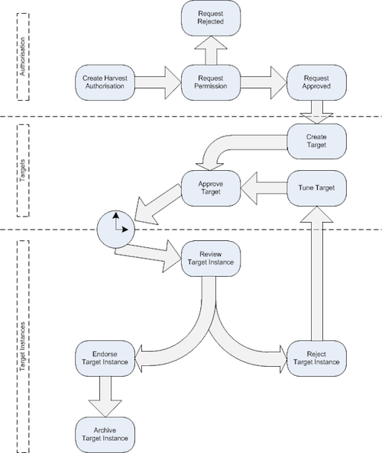
Pre-Legal Deposit Workflow
Nomination
Authorisation
Harvesting
Quality Assurance
Submission
Ingest
Indexing
Access

Slide 6
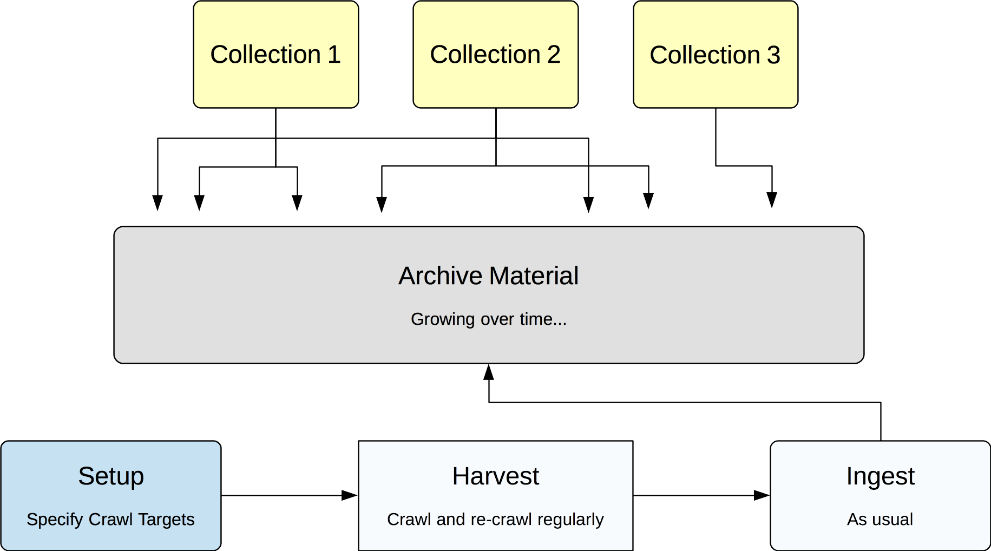
Collection Decoupled From Curation

Slide 7
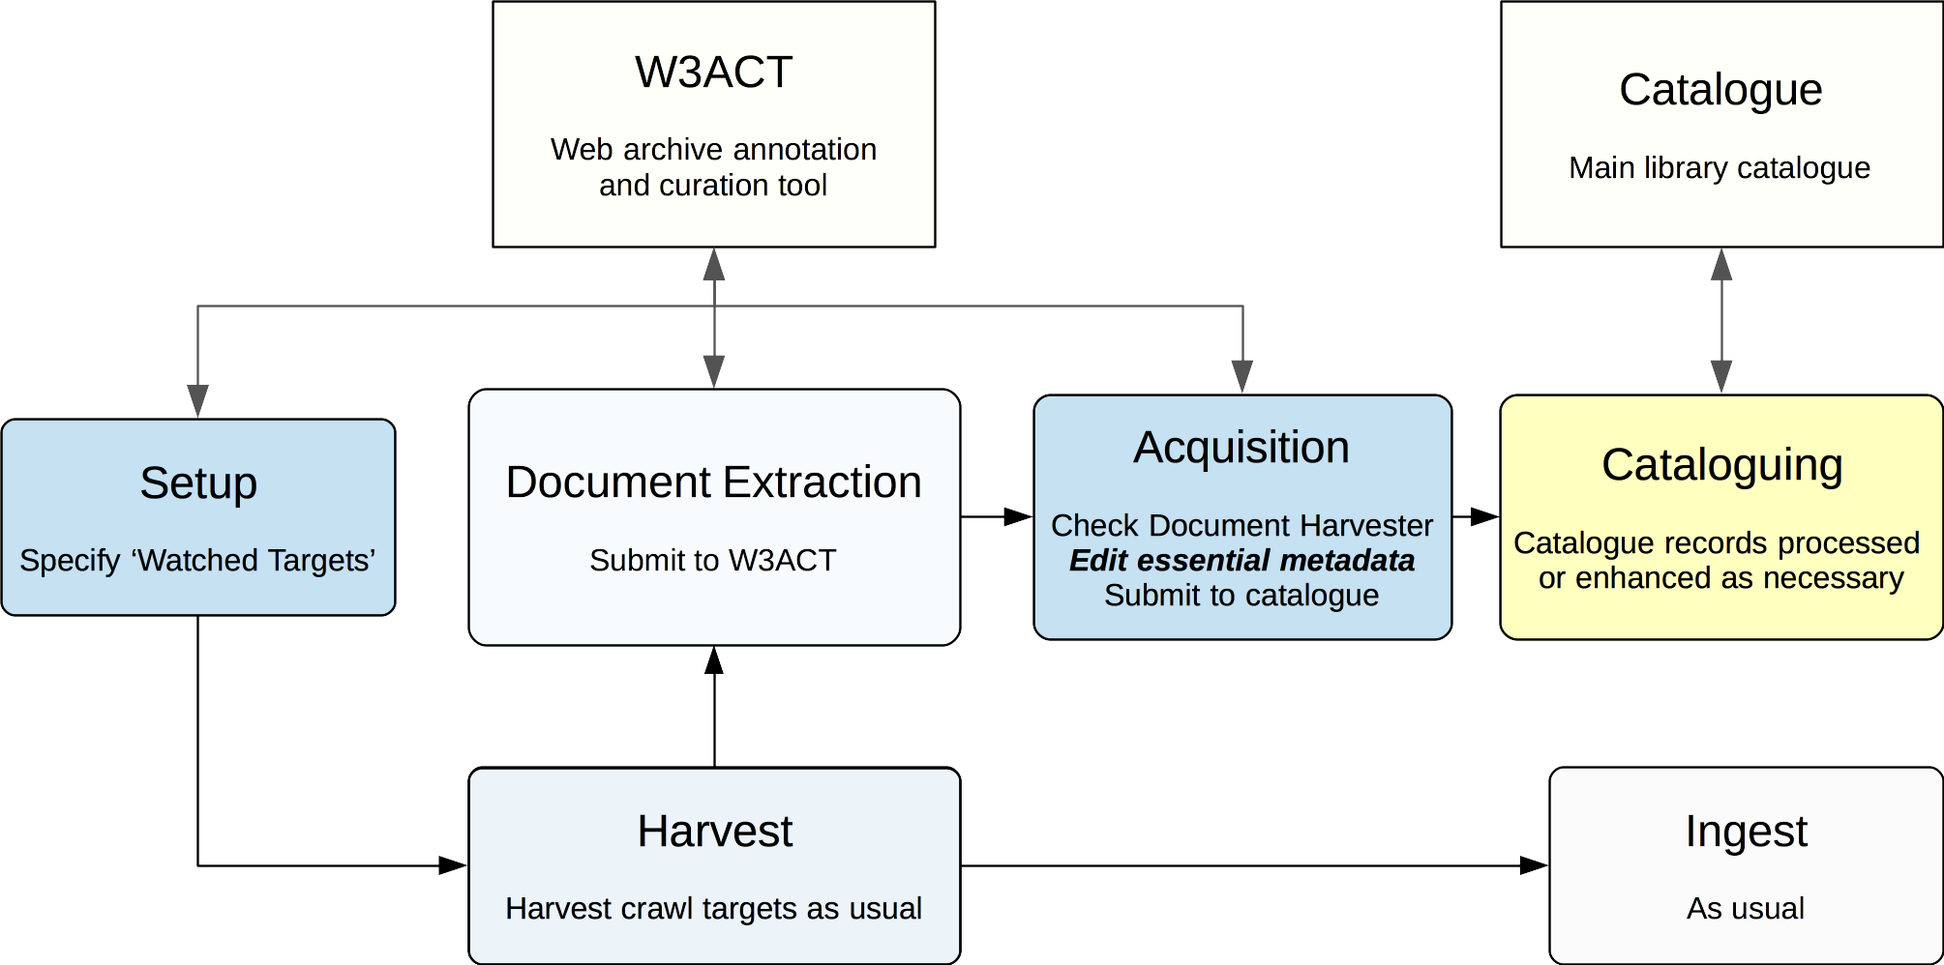
Document Harvester

Slide 8
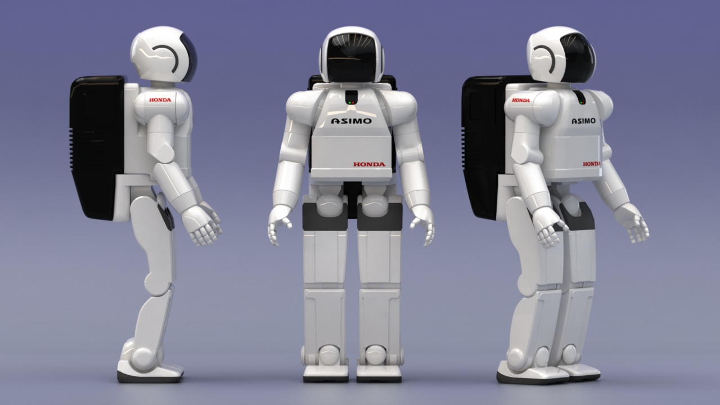
Helpful Robot Army

Slide 9

Disagreeable Robot Army

Slide 10
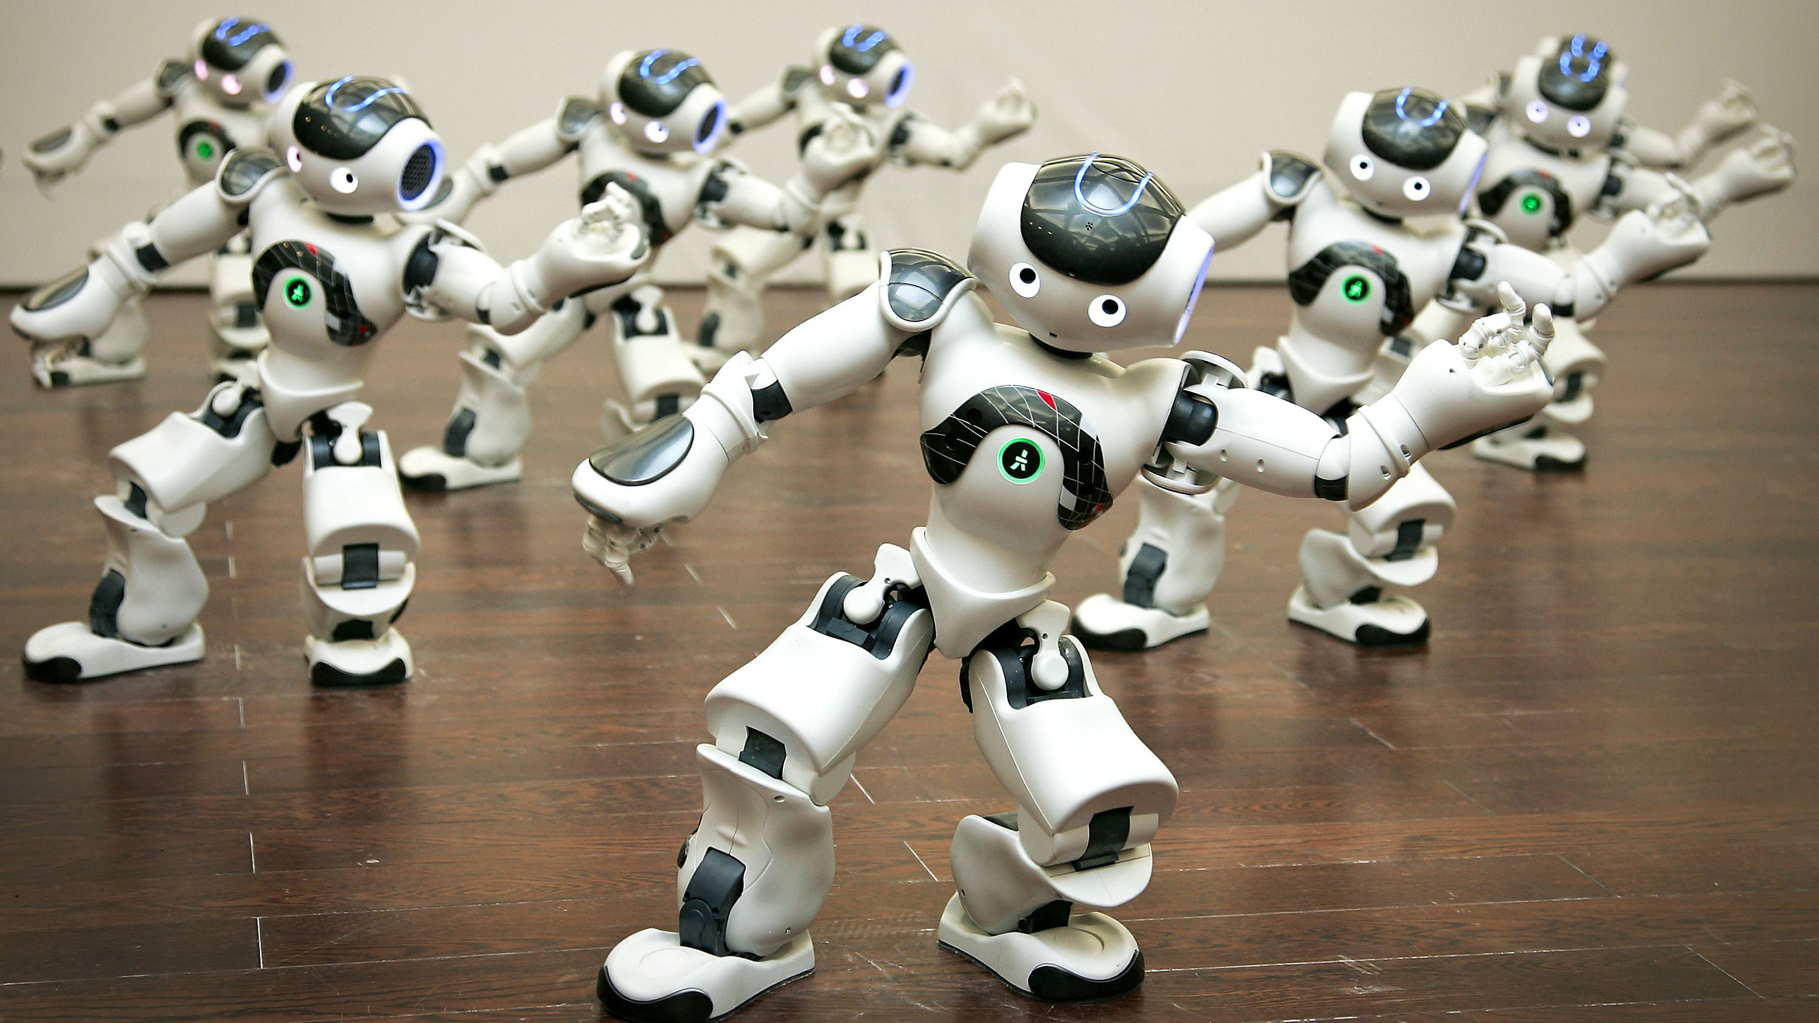
Friendly Robot Army

Slide 11
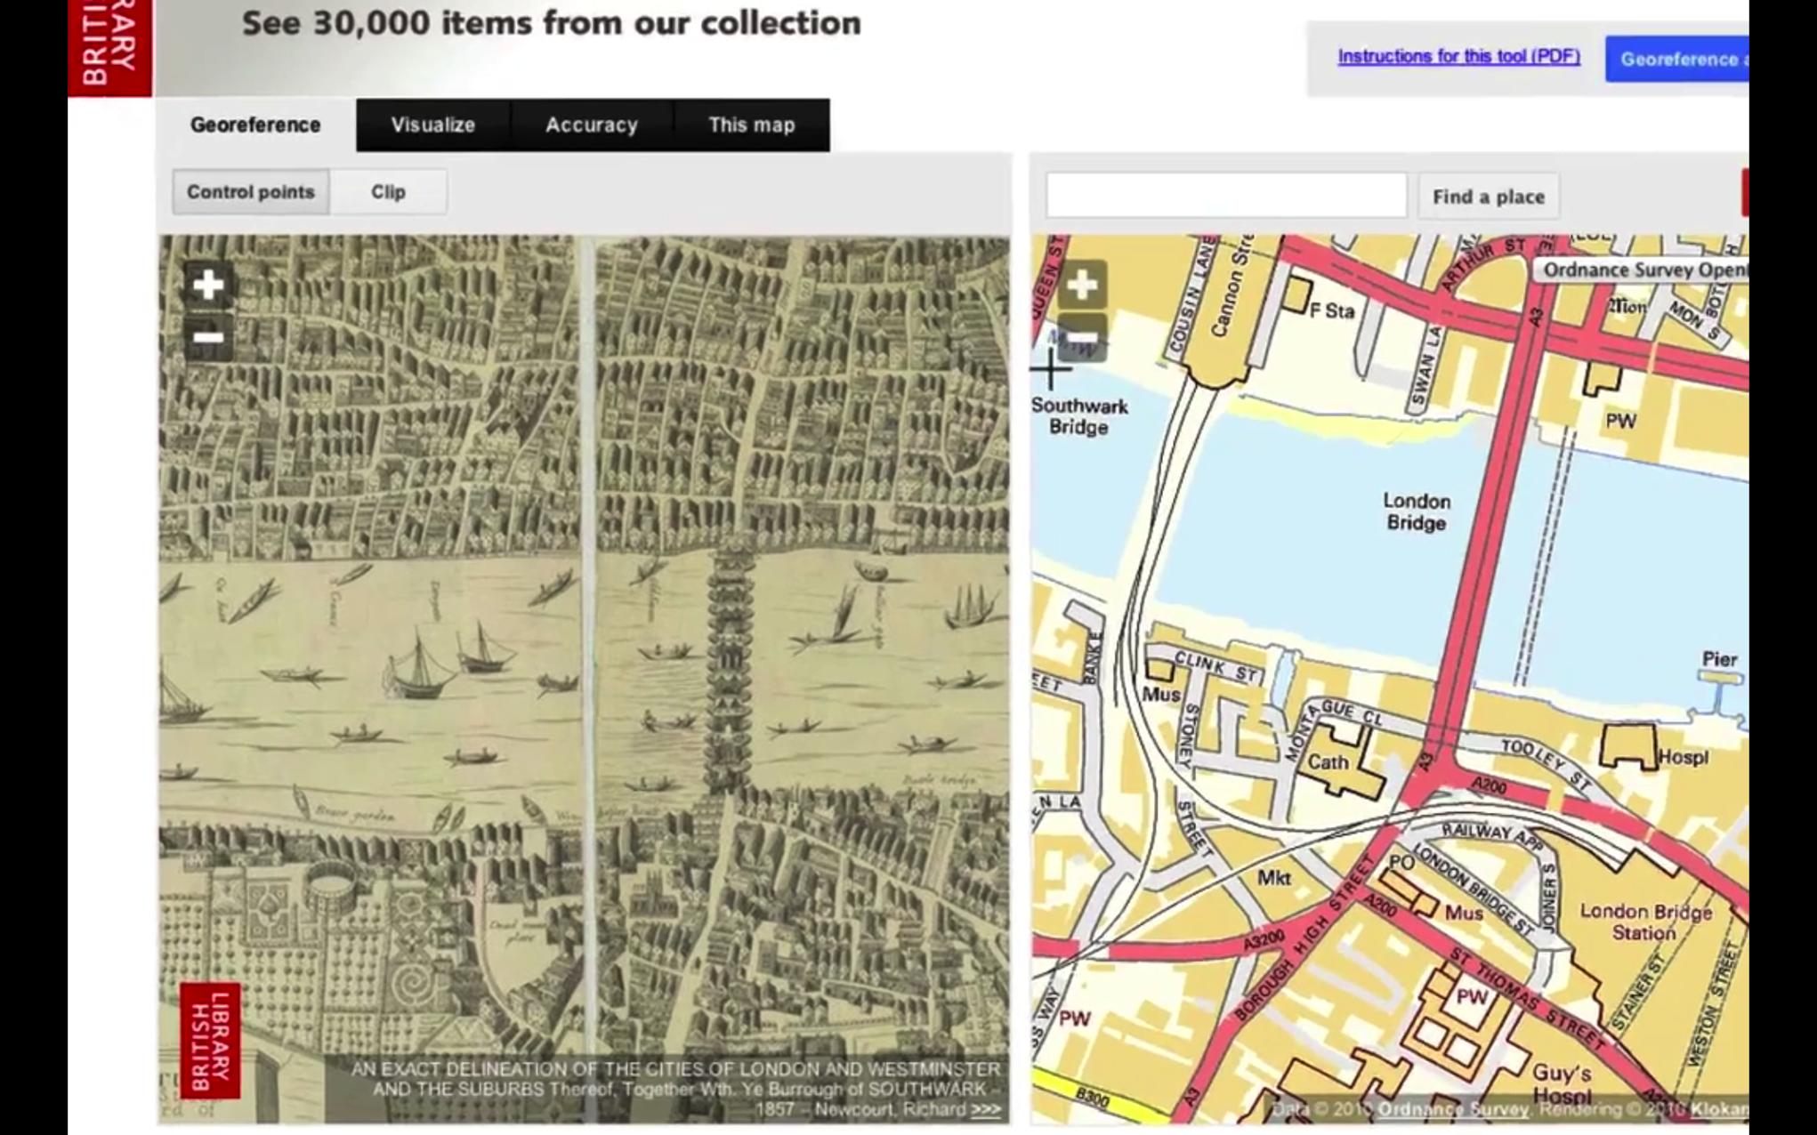
Georeference Editor

Slide 12
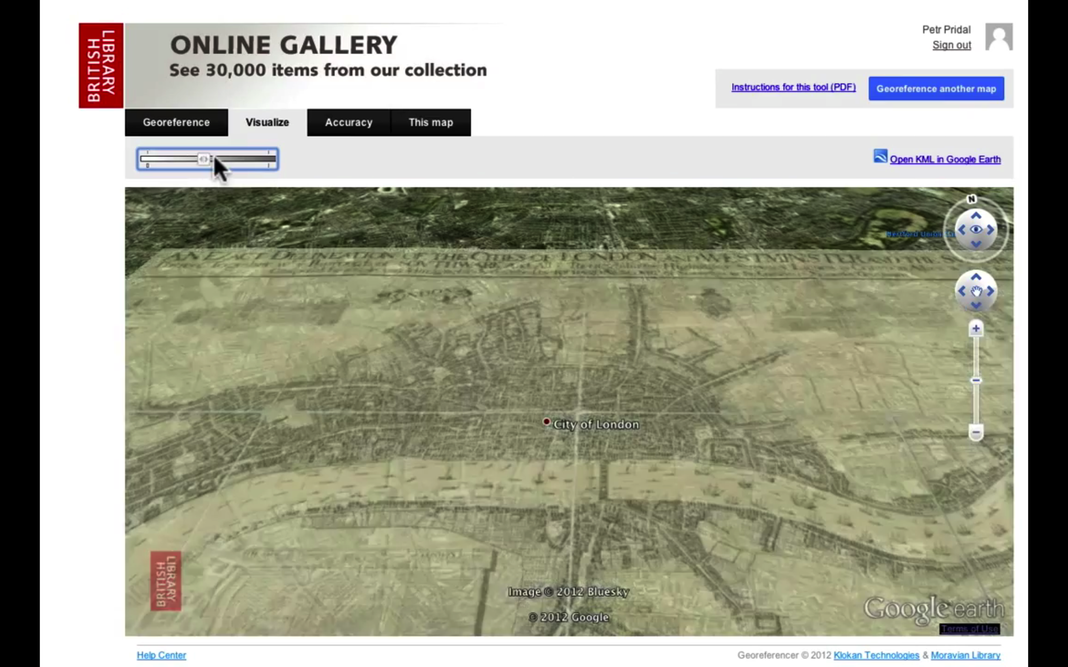
Georeference Result

Slide 13
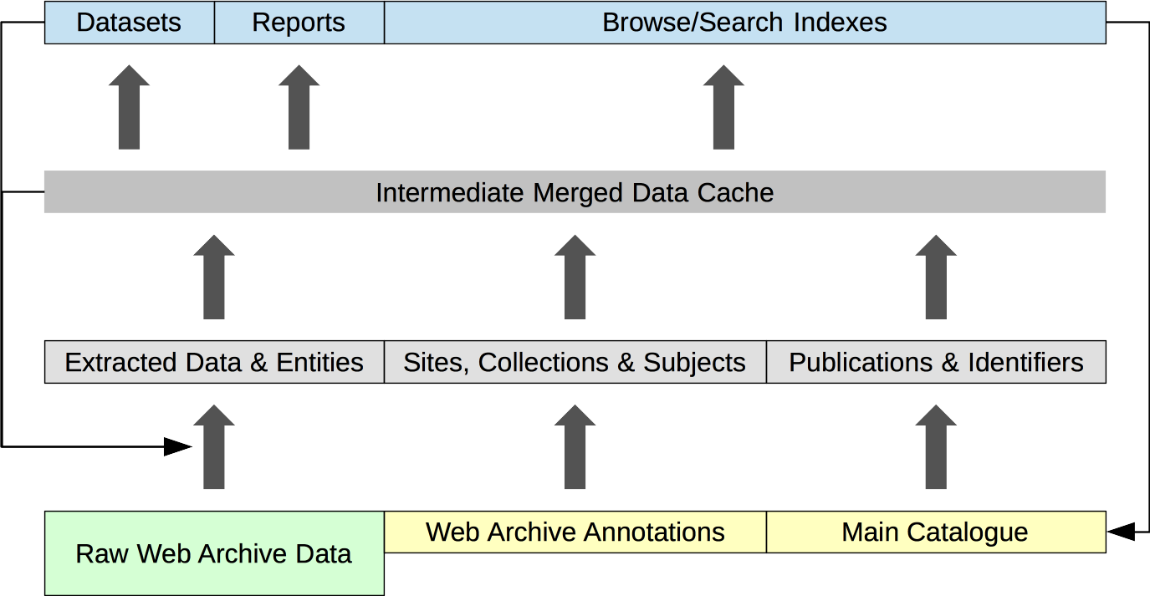
Layers of Transformation

Slide 14
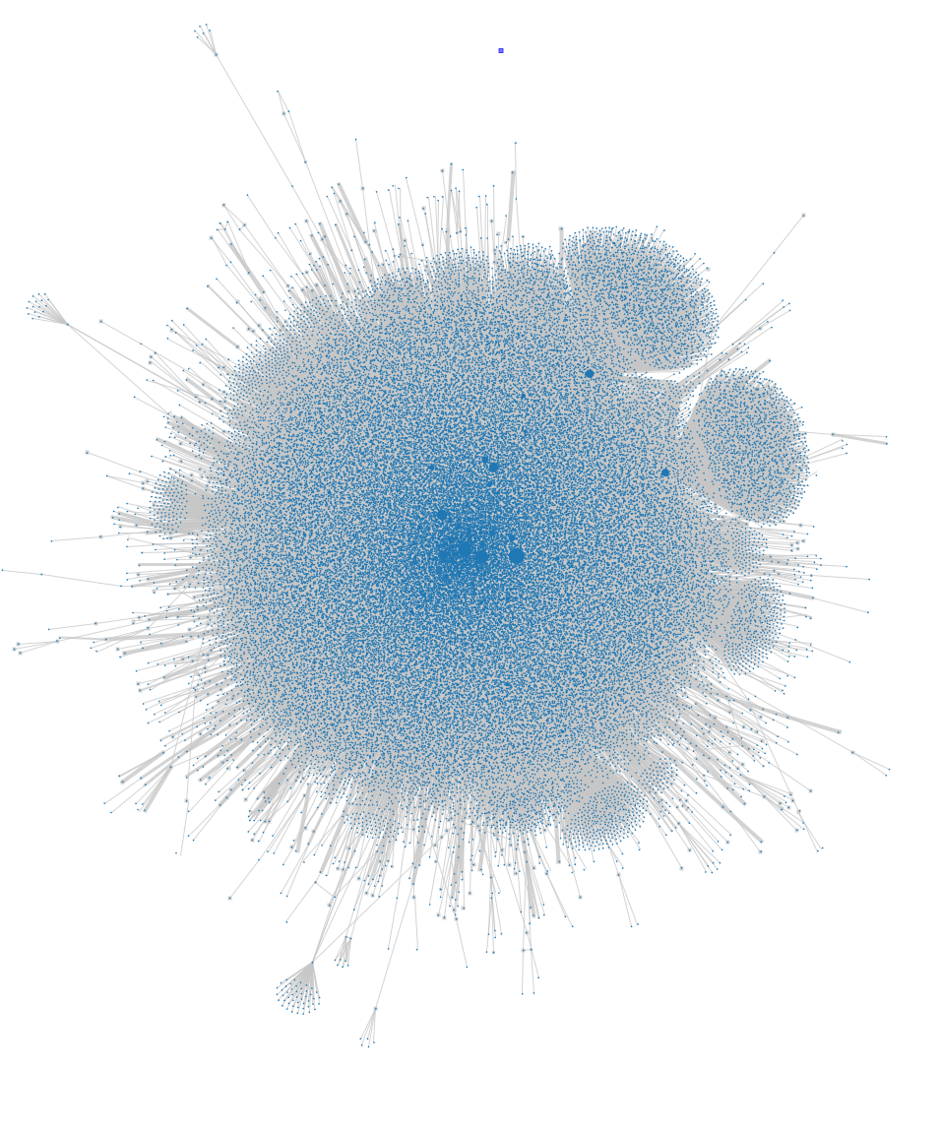
Summary
The catalogue tends to focus on chains of operation and backlogs, item by item
The web archive tends to focus on transformation (and re-transformation) of data
Layered data model can bring them together
Means revisiting the data (but fixity-checking requires this anyway)
Costly in terms of disk space required
Allows rapid exploration and experimentation

